Slide 1


micro:bit robot entry tutorial
Lesson 10
micro:bit advanced lesson 10 “Servo control”
YahBoom micro:bit video tutorial

Slide 2
micro:bit robot entry tutorial
Content
Part1
Part 2
Part3
Part 4
Learning goals
Preparation
Search for blocks
Combine blocks
YahBoom micro:bit video tutorial

Slide 3
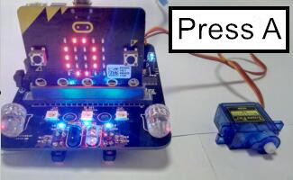
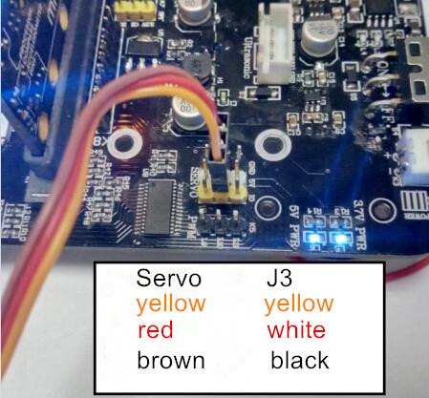
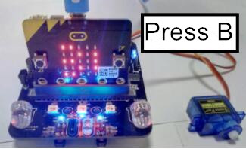
micro:bit robot entry tutorial
Part 1
Learning goals
After you downloaded a good program download the program, press A key, you can see the servo to 0 degrees, while the dot matrix display 0, and then press the B key, you can see the servo to 180 degrees, while the lattice display value 180, the children also do it yourself, try to drive a steering gear bar.
YahBoom micro:bit video tutorial

Slide 4
micro:bit robot entry tutorial
Part 2
Hardware:
● 1 X BBC micro:bit
● 1 X micro:bit expansion board
● 1 X USB cable
● 1 X Servo
Preparation
Then the micro:bit is connected to the computer through USB, and the computer will pop up a U disk and click the URL in the U disk to enter the programming interface. Input this URL https://github.com/lzty634158/yahboom_mbit_en to get the package.
YahBoom micro:bit video tutorial

Slide 5
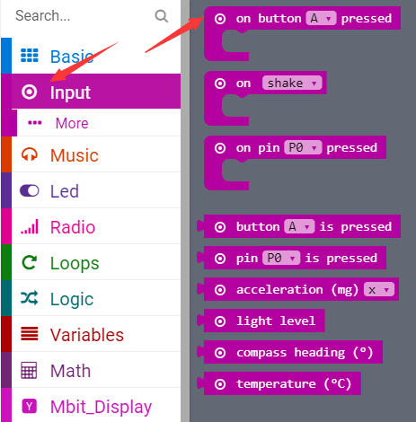
micro:bit robot entry tutorial
Part 3
Search for blocks
YahBoom micro:bit video tutorial

Slide 6
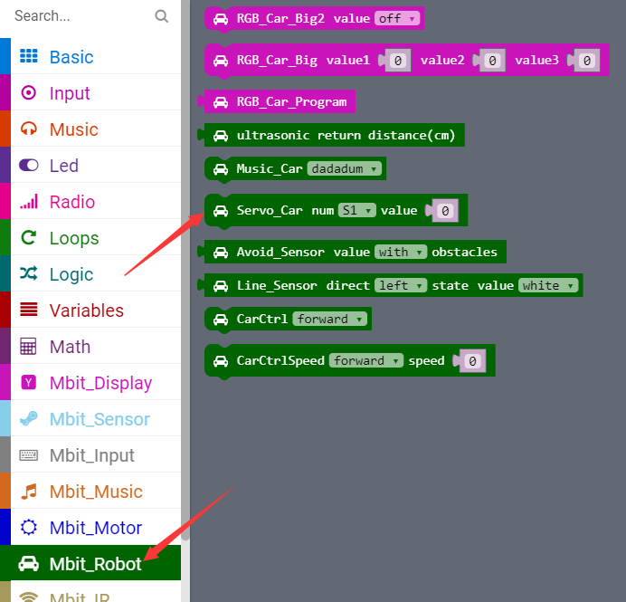
micro:bit robot entry tutorial
Part 3
Search for blocks
YahBoom micro:bit video tutorial

Slide 7
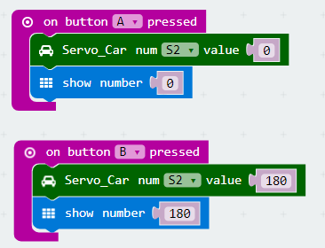
micro:bit robot entry tutorial
Part 4
Combine blocks
YahBoom micro:bit video tutorial

Slide 8
micro:bit robot entry tutorial
robot
lesson
Thanks for watching！
Powered by YahBoom
YahBoom micro:bit video tutorial

